Slide 1
Extract, transform, load
MTN.BI.08
PL/SQL Techniques
Elias Nema
Senior Software Engineer
Elias_Nema@epam.com

Slide 2
Agenda
Exception Handling
PL/SQL Warnings

Slide 3
Exceptions handling

Slide 4
Exception Overview
An internally defined exception is one that is raised internally by an Oracle. An example of an internally defined exception is ORA-00060 (deadlock detected while waiting for resource).
A predefined exception is an internally defined exception that is assigned a name by PL/SQL. Most predefined exceptions are defined in the STANDARD package (e.g. ORA-00001 is assigned the name DUP_VAL_ON_INDEX).
A user-defined exception is one you have declared in the declaration section of a program unit.

Slide 5
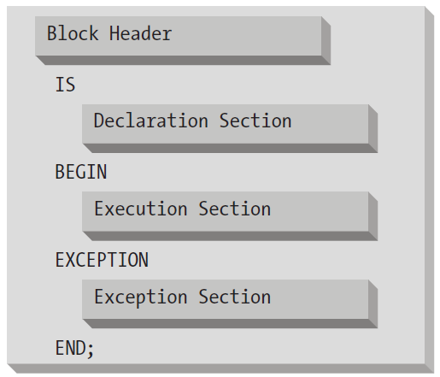
Exceptions
PL/SQL allows developers to raise and handle errors (exceptions) in a very flexible and powerful way. Each PL/SQL block can have its own exception section in which exceptions can be trapped and handled (resolved or passed on to the enclosing block).

Slide 6
How to Raise?
The Oracle will do it ☺
The RAISE statement
The RAISE_APPLICATION_ERROR built-in procedure

Slide 7
Declaring
DECLARE
exception_name EXCEPTION;
PRAGMA EXCEPTION_INIT (exception_name, error_number);
-----
DECLARE
ObjectExists EXCEPTION;
PRAGMA EXCEPTION_INIT (ObjectExists,-955);
sql_stmt VARCHAR2(100) := 'CREATE TABLE mydual AS SELECT * FROM dual';
BEGIN
EXECUTE IMMEDIATE sql_stmt;
-- Ignore ORA-955 errors (object already exists)
EXCEPTION WHEN ObjectExists THEN NULL;
END;

Slide 8
What is in?
The error code. This code is useful when you need to look up generic information about what might cause such a problem. SQLCODE (Note: You cannot call this function inside a SQL statement)
The error message. This text often contains application-specific data such as the name of the constraint or the column associated with the problem. SQLERRM or DBMS_UTILITY.FORMAT_ERROR_STACK (Note: You cannot call SQLERRM inside a SQL statement)
The line on which the error occurred. DBMS_UTILITY.FORMAT_ERROR_BACKTRACE
The execution call stack. This answers the question “How did I get here?” and shows you the path through your code to the point at which it is called. DBMS_UTILITY.FORMAT_CALL_STACK

Slide 9
WHEN OTHERS
Catch any exception:
WHEN OTHERS
THEN
You can have multiple WHEN clauses in your exception section, but if you have a WHEN OTHERS clause, it must come at the end.

Slide 10
Pl/sql warnings

Slide 11
Warnings
By default, PL/SQL warnings are disabled. PL/SQL warnings can be enabled at the system, session, or procedure level. PL/SQL warnings are divided into three categories:
Severe: These are warnings about code that contains a conflict with functions in SYS.STANDARD or SQL functions.
Performance: These are warnings about code that may have a performance impact, such as the use of wrong data types in queries and the lack of use of NOCOPY compile directive when appropriate.
Informational: These are warnings relating to code that does no harm and/or may even be removed.

Slide 12
Monitoring WHEN OTHERS warning
ALTER SESSION SET plsql_warnings = 'enable:all'
CREATE OR REPLACE PROCEDURE wo_prc AS
BEGIN
DBMS_OUTPUT.put_line ('I am here!');
RAISE NO_DATA_FOUND;
EXCEPTION
WHEN OTHERS
THEN NULL;
END wo_prc;
Errors for PROCEDURE WO_PRC:
LINE/COL ERROR
-------- -----------------------------------------------------------------
7/9 PLW-06009: procedure "PLW6009_DEMO" OTHERS handler does not end
in RAISE or RAISE_APPLICATION_ERROR

Slide 13
PL/SQL Techniques
Elias Nema
Senior Software Engineer
Elias_Nema@epam.com

